Slide 1
Data analytics
Data Analytics for Customer Churn In Telecom

Slide 2
Project GOALS
Churn is problem in Telecom Industry and which is much more critical with Mobile Number Portability. Telecom Companies want to identify churn and prevent Churn by offer discounts to customer so that they don’t switch. So we use classified machine learning techniques in our data analytics to identify Churners early and Churn score to prevent future churn .

Slide 3
Data SET
Data is taken from kddnuggets which hosts sample datasets for machine learning. These are real time data but masked for privacy purposes. This site is a popular site for Sample Datasets for machine learning exercises
A test data generator is used to generate test data. Mockaroo allows you to quickly and easily to download large amounts of randomly generated test data based on your own specs which you can then load directly into your test environment using SQL or CSV formats. No programming is required.

Slide 4
Attributes of the dataset
Column Name Description
1 State The state in which customer resides.
2 Account. Length The subscription period.
3 Area. Code The pin code of customers residence.
4 Phone The contact number of the customer.
5 Int .l .Plan The data plan of the customer.
6 VMail.Plan Cost required to activate the plan.
7 VMail.Message The frequency of messages per day.
8 Day.Mins Total call duration per day in mins.
9 Day.Calls No of calls per days.

Slide 5
10 Day.Charge Per day charges of the customer.
11 Eve. Mins Evening call duration in mins.
12 Eve.Calls Evening calls of the customer.
13 Eve.Charge Charges applied for evening calls.
14 Night.Mins Night call duration in mins.
15 Night.Calls Night calls of the customer.
16 Night.Charge Charges applied for night calls.
17 Intl.Mins International call duration in mins.
18 Intl.Calls International calls of the customer.
19 Intl.Charge Charges applied for international calls.
20 CustServ.Calls Customer service calls.

Slide 6
Progress of the project
Pre processed the raw data collected.
Installed R tool kit.
Modeling the phases
learning R to develop logistic regression algorithm to run over the datasets
Learning R to generate graphs
Visualize Datasets using SAP Lumira

Slide 7
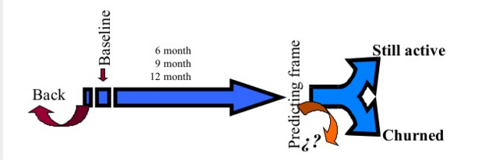
Modeling phase
We will use Logistic Regression to fit models and predict Churn on historical data. Once this is done, we will evaluate the model on different statistical parameters to determine model Fit. The Model with the best results will chosen to test on the holdout Sample.

Slide 8

Model evaluation and scoring
After Model is evaluated based on the performance on the Hold Out Sample, the model is scored in real time to identify churners on real data.
P= Probability of getting the condition of “churn” .
P=0 customer will remain active.
P=1 customer will churn.
LOGISTIC REGRESSION :-

Slide 9
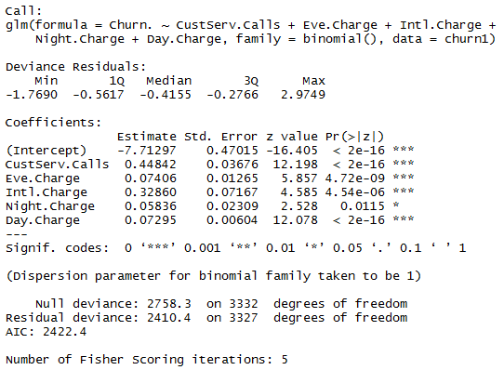
Logistic Regression in R

Slide 10
Description of srs
1.External Interface Requirements
User interface : In the form of visualization of data , eg.bar graph.
Hardware interface : Doesn’t have any designated hardware so no specific hardware interface.
Software interface : Software communicates with datasets acquired and an algorithm is run on them to predict the churn score.
Communication Interface :The communication between the different parts of the system is important since they depend on each other but the way of communication is not important.
2. Functional requirements
a) Collect data from the client and form data set
b) Run the algorithm on the obtained data sets
c) Predict the churn score using linear regression
d) Submit the result to the client

Slide 11
3. Software System Attributes
Reliability
TAG: SystemReliability
GIST: The reliability of the system.
SCALE: The reliability that the algorithm derives the right churn score.
METER: Churn score obtained from 100000 datasets during testing.
MUST: More than 98% of the datasets.
PLAN: More than 99% of the datasets.
WISH: 100% of the datasets.
4. Performance requirements
Database transactions per second
Accuracy of the churn score
Response time

Slide 12
5.Database requirements
We require SQL Server Name with the following :
Database
Name
Size
Anticipated growth rate or capacity planning
Database configurations
Storage configurations
Data
Data elements
Tables
Columns
6. Design Constraints
Complexity of Logistic algorithm
All coding will be done in R.
Logistic regression requires huge amount of data to achieve stable and meaningful output.

Slide 13
Description of the design
Data Identification and Selection
Preprocessing and reducing variables
Transforming Data and creating Input Data for Modeling
Fitting Models and identify Significant Variables
5. Interpreting Model results and Scoring new data and testing on hold out Sample

Slide 14
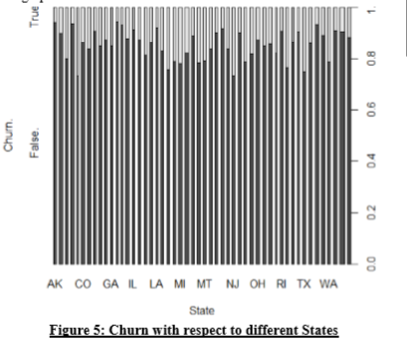
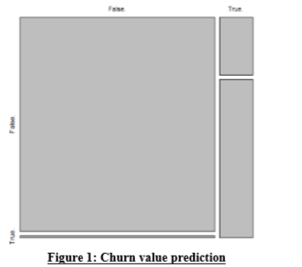
PREPROCESSING and transformation
Preprocessing involves transforming variables and creating new variables like frequency count, last 3 months total roaming calls, total duration of calls
After the data is processed, we examine the data visually as part of Exploratory Data Analysis. For example a histogram, bar charts or Pie charts

Slide 15
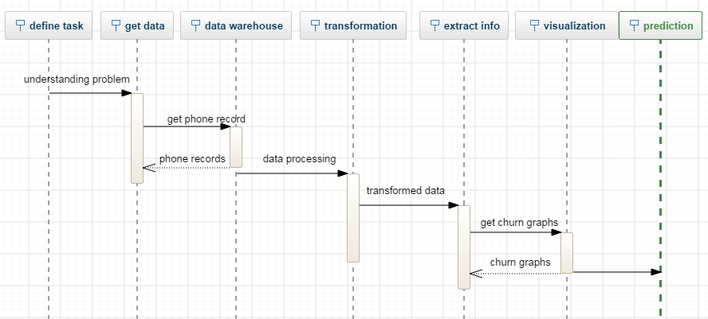
Sequence diagram

Slide 16
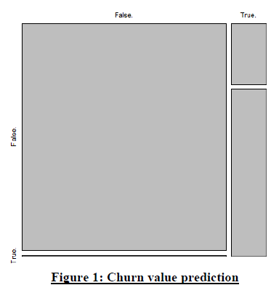
Result and snapshots

Slide 17
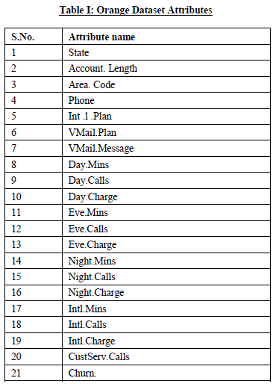

Slide 18
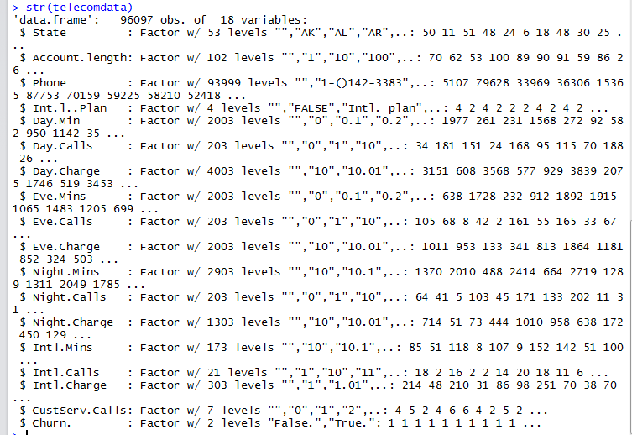

Slide 19
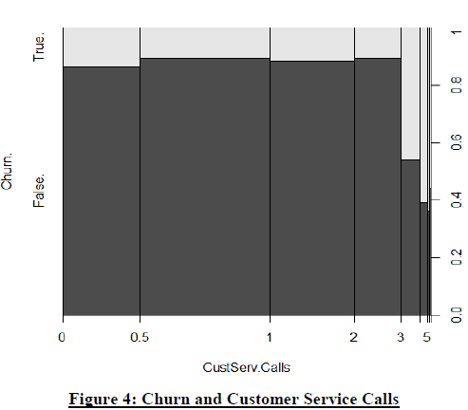

Slide 20
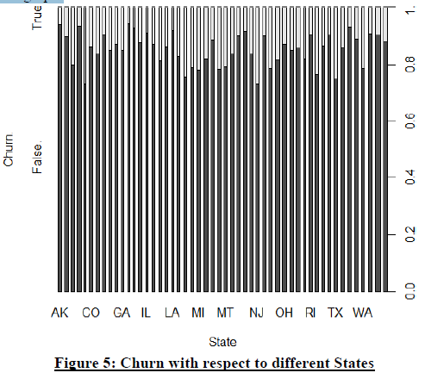

Slide 21
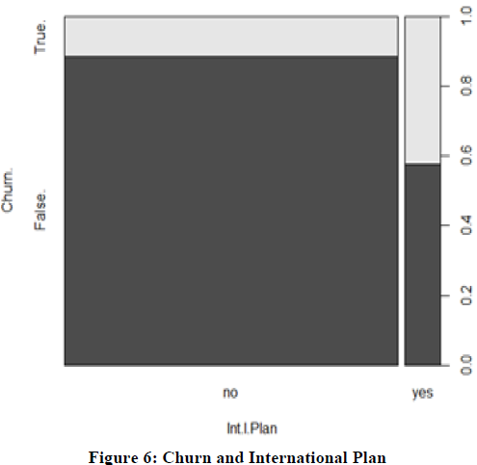

Slide 22
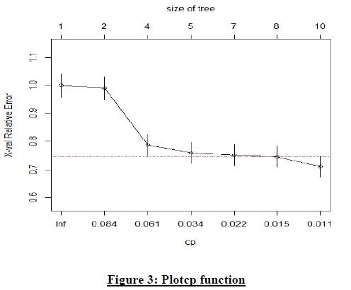

Slide 23
Visualization in sap lumira

Slide 24
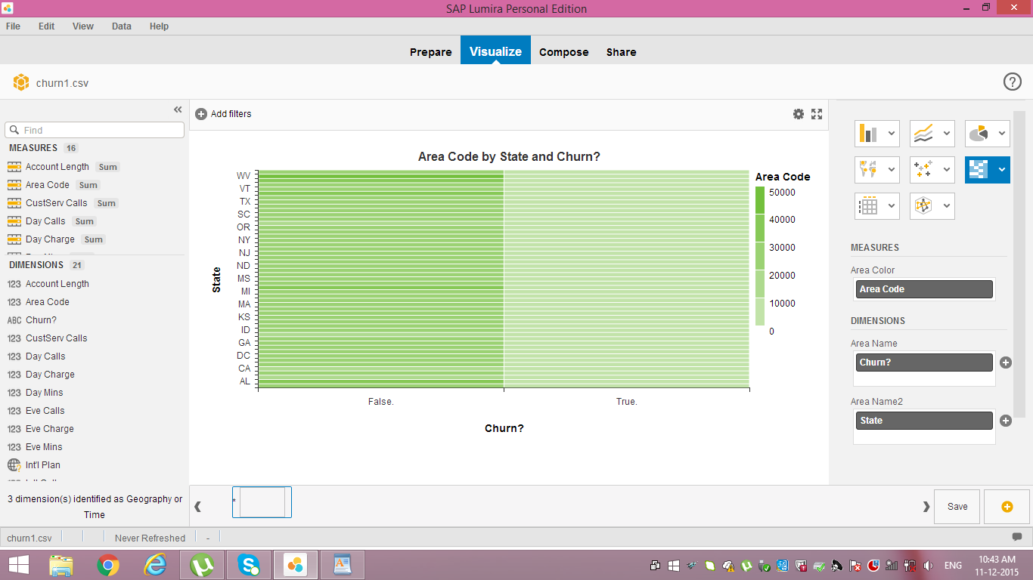
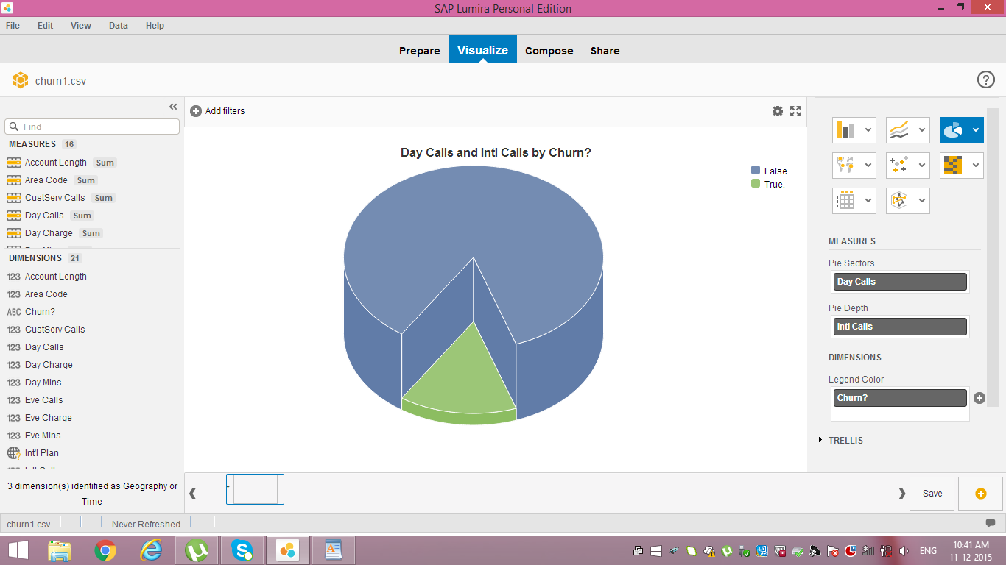

Slide 26
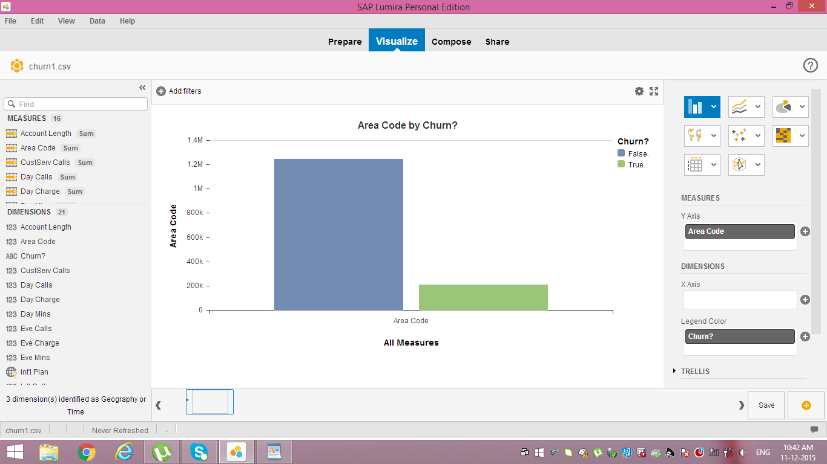

Slide 27
end

